Slide 1

HEALTH & SAFETY INDUCTION FOR CONTRACTORS

Slide 2
INTRODUCTION
  This Induction session must be completed by all contractors before commencing work for Technological University of the Shannon: Midlands Midwest
  Only Contractors who have completed this course are allowed to commence work on any Premises owned or occupied by TUS.

Slide 3
INTRODUCTION
Failure to observe the requirements of this induction,
or any instruction from your TUS point of contact or Health & Safety Officer,
may result in:
Instruction to leave site immediately
the termination of the contract
prohibition on future employment.

Slide 4
DUTY OF TUS
TUS Midlands MidWest in compliance with the Safety, Health and Welfare at Work Act 2005 and associated Regulations shall, as far as is reasonably practicable, provide a safe place of work for:
staff
students
visitors
contractors and
members of the public.

Slide 5
OBLIGATIONS ON
CONTRACTORS
Provide TUS with;
Current Copy of Safety Statement
Current Insurance Details
Risk Assessments
Method Statements as Appropriate
Training records e.g.:
  MEWP
  Work at Height
  Fall Arrest
  Manual Handling

Slide 6
OBLIGATIONS ON
CONTRACTORS
Provide employees with;
Provide employees with information, instruction,
training and supervision.
And with personal protective equipment and
ensure that it is used.

Slide 7
DUTY OF CONTRACTORS
While on site at TUS you must:
Cooperate with all Estates staff and the Health & Safety Officer
Work in a safe manner at all times
Wear PPE as appropriate
Work as directed by TUS Supervisor and RAMS

Slide 8
DUTY OF CONTRACTORS
While on site at TUS you must:
Report all dangerous occurrences, near misses, accidents, incidents immediately to your TUS supervisor and/or the Health & Safety Officer
First aid kits and fist aiders, defibrillators, epi-pens at caretakers offices/reception in all Campuses.
Not be under the influence of an intoxicant (alcohol or drugs)
Not put yourself or anyone else at risk form fire

Slide 9
DUTY OF CONTRACTORS
While on site at TUS you must:
Not represent yourself as to the type and level or training
Specifically for higher risk activities such as confined space, work at height, MEWP, fall arrest etc.
The contractor must ensure that work is only undertaken by appropriately competent personnel

Slide 10
OBLIGATIONS ON
CONTRACTORS
On Arrival Report to:
TUS Supervisor/
Reception/
Caretakers
Depending on the campus
Sign In on arrival and sign out when leaving.

Slide 11
OBLIGATIONS ON
CONTRACTORS
Smoking is prohibited in all buildings
And within 6 metres of all entrances, and openings
This includes e-cigerettes!

Slide 12
OBLIGATIONS ON
CONTRACTORS
Access confined to specific work area.
We need to know where you are working at all times.
Hazards present in TUS:
Chemicals
Biological Agents
Electricity & Machinery
Asbestos
Roof work/work at height

Slide 13
PARKING
Contractors may use any of the Student Car Parks or park in areas assigned by TUSs Responsible Person.
Parking in unauthorised areas may result in Clamping.
Parking Permits may be obtained, as appropriate, from the Estates Office.
Speed limit of 15kM/h on all campuses

Slide 14
Planning Work
Work must be planned, appropriately scheduled and risk assessed.
Advance notice given to TUS responsible person of dates and times.
Risk Assessments and/or method statements may be requested.
Advance notice must be given for work permits.

Slide 15
OBLIGATIONS ON
CONTRACTORS
Work permits:
Confined space
Roof access
Hot Works

Slide 16
OBLIGATIONS ON
CONTRACTORS
All hot works involving:
welding
cutting /grinding equipment
brazing
bitumen boilers
naked flames or any other equipment producing heat
must not commence without a method statement and a first obtaining a Hot Work Permit.

Slide 17
OBLIGATIONS ON
CONTRACTORS
Flammable liquids, gases must be stored in
appropriately labelled containers in a secure well
ventilated area out of doors (Never in Operational
Buildings)

Slide 18
OBLIGATIONS ON
CONTRACTORS
WASTE
Remove all waste
Waste must be disposed of in compliance with
Local Authority Regulations and
National Legislation.
Where hazardous waste is disposed of a copy of the
Disposal Certificate must be furnished to TUS

Slide 19
OBLIGATIONS ON
CONTRACTORS
Contractor employees must not interfere with or
misuse any appliance, equipment or other means
or thing provided by TUS to ensure safety.

Slide 20
OBLIGATIONS ON
CONTRACTORS
Work areas must be appropriately cordoned off
to prevent access to unauthorised personnel.
Work areas must be kept free of obstructions,
slip and trip hazards as far as possible.
The worksite must be secure particularly after duty hours
to prevent unauthorised access
Materials, tools, equipment etc. may only be stored in locations agreed with Responsible TUS Person.

Slide 21
OBLIGATIONS ON
CONTRACTORS
Ensure that exits and escape routes are kept
clear at all times
Report all spills as soon as they occur
Report defects to the Responsible TUS Person
Report all damage to TUS property no matter
how minor to the Responsible Person

Slide 22
OBLIGATIONS ON
CONTRACTORS
University welfare facilities must be maintained in
a safe, clean and hygienic condition.
Food shall only be consumed in designated areas

Slide 23
OBLIGATIONS ON
CONTRACTORS
The contractor shall not carry out work of a
noisy nature without prior approval from the
Responsible TUS Person

Slide 24
OBLIGATIONS ON
CONTRACTORS
Before the commencement of work internally
which is likely to generate dust, vapours, fumes,
mists, sprays etc. arrangements must be made
with Estates Office to prevent the inadvertent
operation of the Fire Detection and
Alarm System as such agents can affect
smoke detectors.

Slide 25
OBLIGATIONS ON
CONTRACTORS
Gas Welding
Where gas welding has to be carried out in
Buildings the cylinders must be adequately
Secured to prevent falling. The gas lines
must be fitted with Flash Back Arrestors and
the Equipment must comply with BCGA
Guidance.

Slide 26
OBLIGATIONS ON
CONTRACTORS
Work at height must be carried out in compliance with appropriate legislation associated regulations and best practice.
  Most importantly, as per your work at height training!

Slide 27
OBLIGATIONS ON
CONTRACTORS
Ladders
You must use your own company ladders – do not use any TUS work equipment unless given specific permission to do so!
Ladders only used when necessary and appropriate.
Training & used in accordance with manufacturers
instructions

Slide 28
OBLIGATIONS ON
CONTRACTORS
Ladders
Only considered where the use of towers,
mobile platforms, scaffolds is not appropriate
Need to justify whether a ladder/stepladder is
the most suitable access equipment
Risk Assessment & Hierarchy of Control
Avoid work at height
Prevent falls from height
Reduce the consequences of a fall

Slide 29
OBLIGATIONS ON
CONTRACTORS
Ladders
Only use ladder/stepladder where work
is of short duration
Low risk – fall unlikely – unlikely to cause injury
For light work – not strenuous or heavy
Does not involve carrying heavy/awkward loads
Where 3 points of contact are maintained
Used only for light work –low risk- short duration

Slide 30
OBLIGATIONS ON
CONTRACTORS
Ladders
Do Not
Overload it – person + equipment
Over-reach – keep belt buckle inside stiles
and both feet on same rung.

Slide 31
OBLIGATIONS ON
CONTRACTORS
Roof Work
Access to roof areas in all TUS Buildings
is restricted to Authorised Competent Personnel
only.
Before accessing any roof authorisation must be
granted by Estates Office

Slide 32
OBLIGATIONS ON
CONTRACTORS
Fall Arrest Equipment:
You must supply your own harnesses and lanyards!
They must be certified and inspected before use.
You must have work at height and fall arrest training!

Slide 33
OBLIGATIONS ON
CONTRACTORS
Mobile Elevating Work Platforms
Personnel working from MEWPs shall
at all times wear a Safety Harness
Failure to do so will result in disciplinary procedures.

Slide 34
OBLIGATIONS ON
CONTRACTORS
Portable Electrical Equipment
Portable Electrical Equipment intended for use in
TUS must have undergone PAT Testing
Test records must be supplied on request to TUS
Plant and equipment must comply with appropriate standards

Slide 35
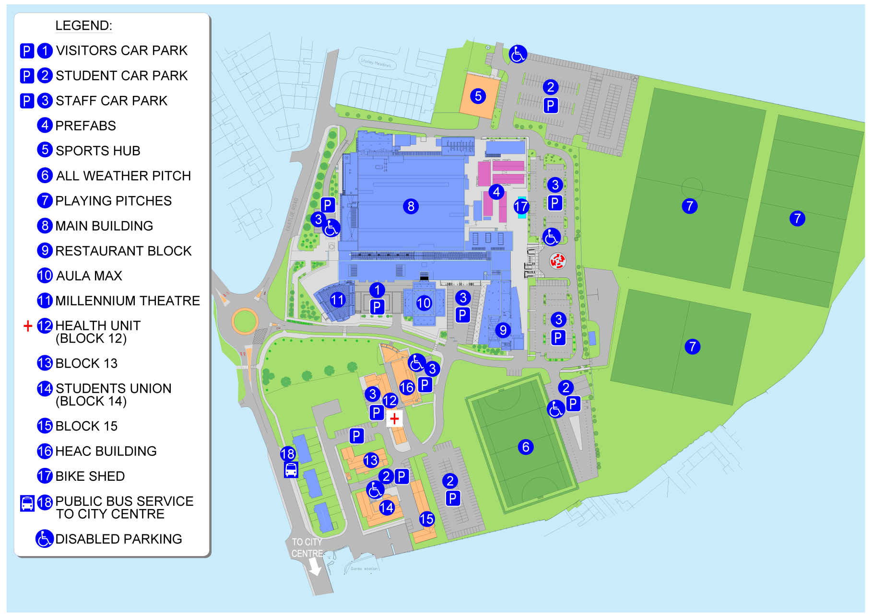

Slide 36
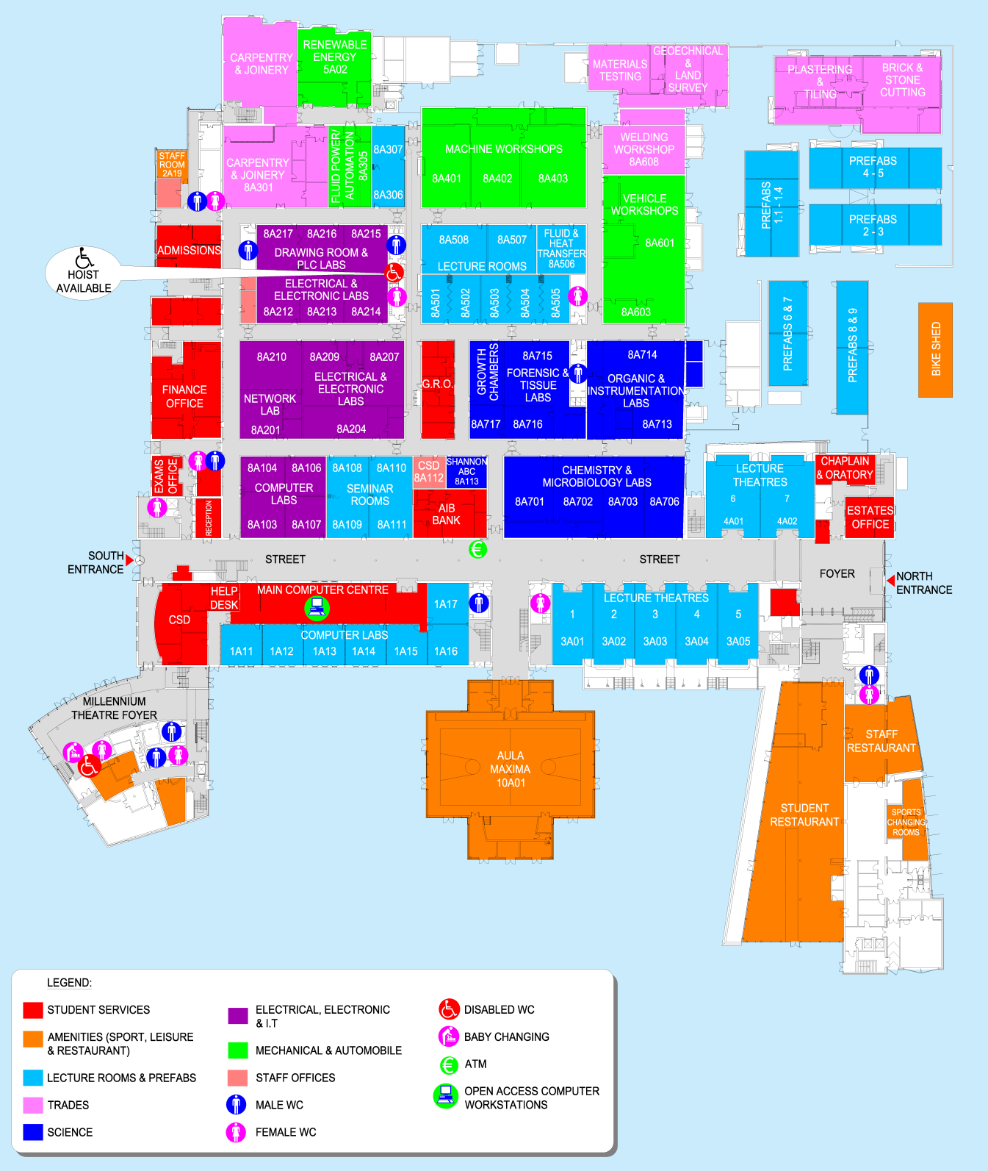

Slide 37
